Slide 1
Producer Adaptation to Climate Change in the Midwest
Eugene S. Takle
Professor
Department of Agronomy
Department of Geological and Atmospheric Science
Director, Climate Science Program
Iowa State University
Ames, IA 50011
Adaptation Work Group Meeting
25 x 25 Alliance
Baltimore, MD
6-7 September 2011

Slide 2
Outline
Changes in climate variables of importance to agriculture in the US Midwest
Climate change contributions to increased production due to adaptation
Producer adaptation to recent climate changes
Challenges to adaptation to future climate change – near term and long term

Slide 3
First Date Iowa’s Average Fall 4-inch Soil Temperature Was Below 50ºF
Iowa Environmental Mesonet 2010

Slide 4
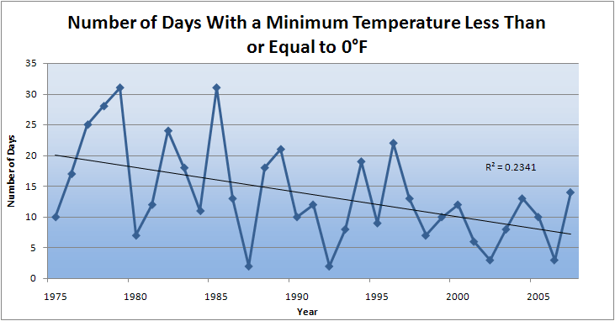
Des Moines Airport Data
Caution: Not corrected for urban heat island effects

Slide 5
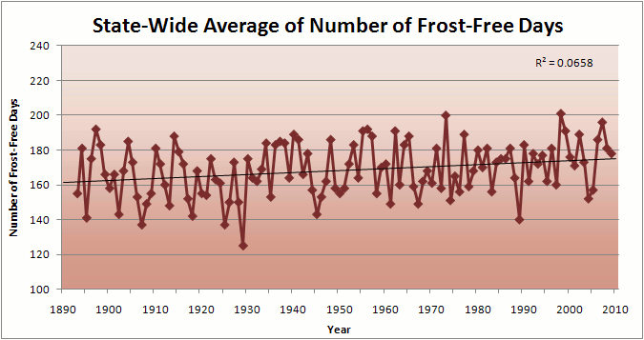
Iowa State-Wide Average Data

Slide 6
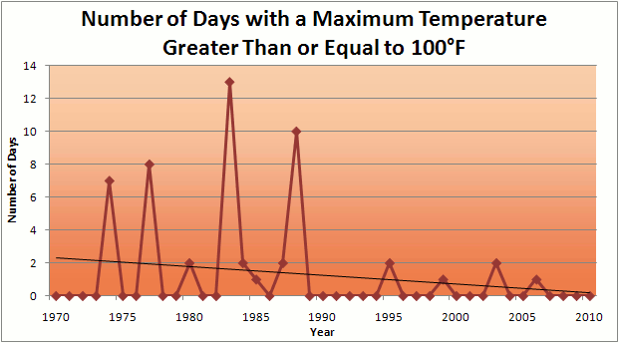
Des Moines Airport Data
1983: 13
1988: 10
1977: 8
6 days ≥ 100ºF in the last 22 years

Slide 7
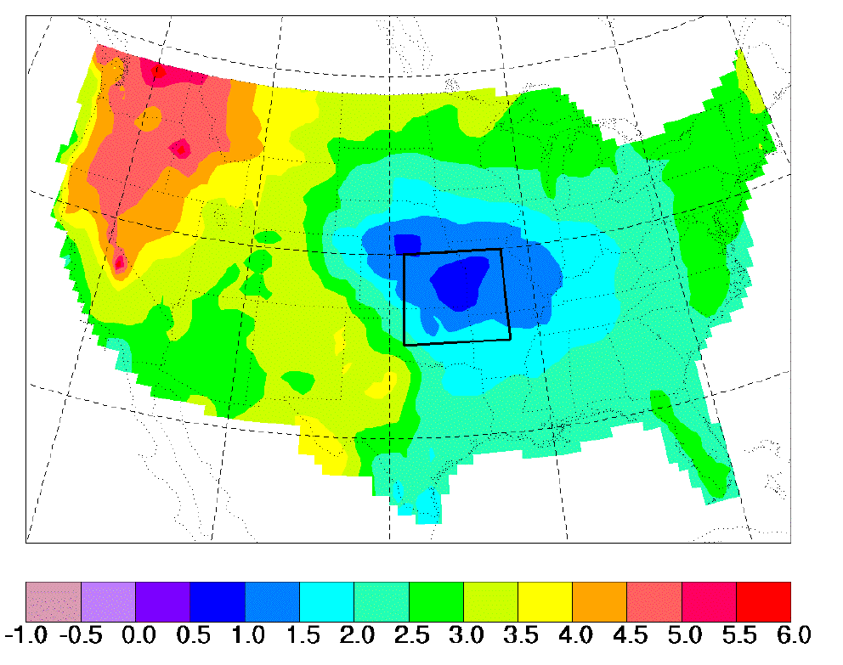
“Warming Hole”:
Regional climate model simulations of changes in daily maximum summertime temperatures between 1990s and 2040s
ΔT_{max} (JJA)
˚C
    Pan, Z., R. W. Arritt, E. S. Takle, W. J. Gutowski, Jr., C. J. Anderson, and M. Segal,2004: Altered hydrologic feedback in a warming climate introduces a “warming hole”. Geophys. Res. Lett.31, L17109, doi:10.1029/2004GL020528.
Notes:
A feature that corresponds to later 20th century trends. Not seen in GCMs. Linked to mesoscale circulation.

Slide 8
Observed Summer (JJA) Daily Maximum Temperature
Changes (K), 1976-2000
Adapted from Folland et al. [2001]

Slide 9
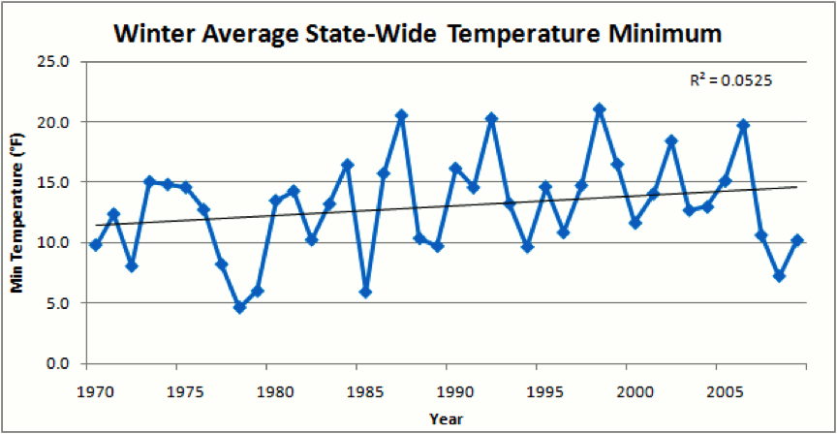
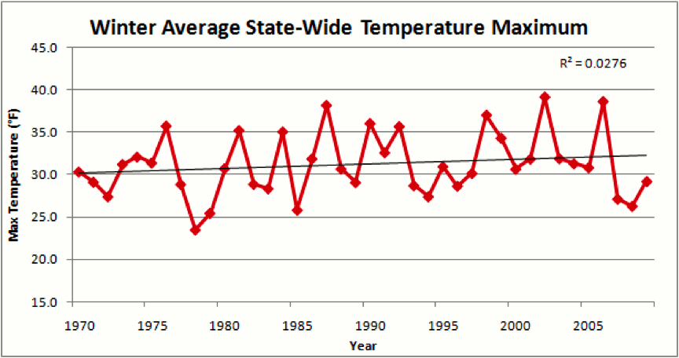
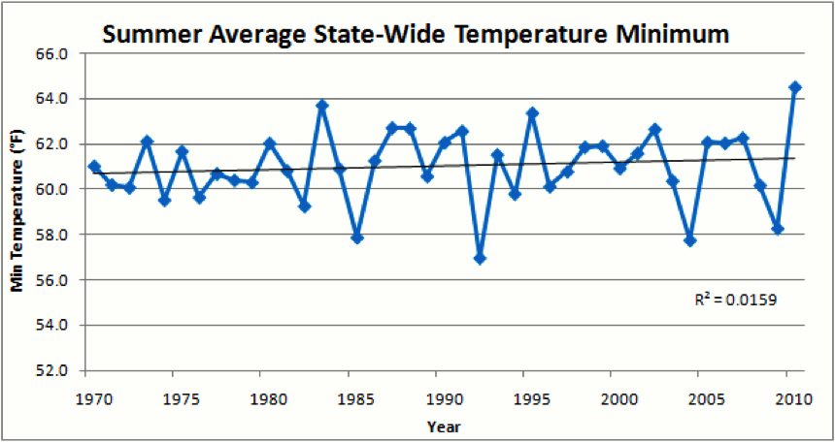
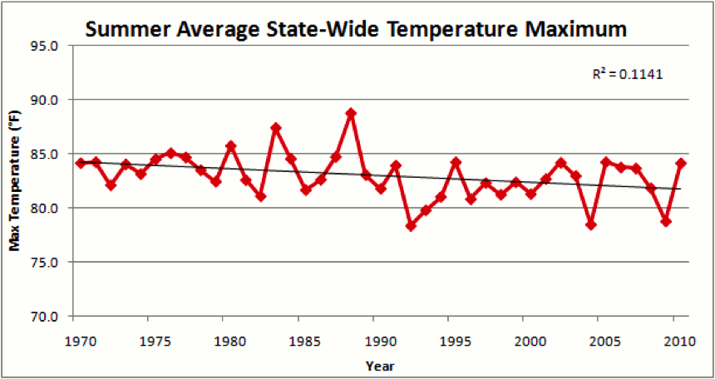

Slide 11
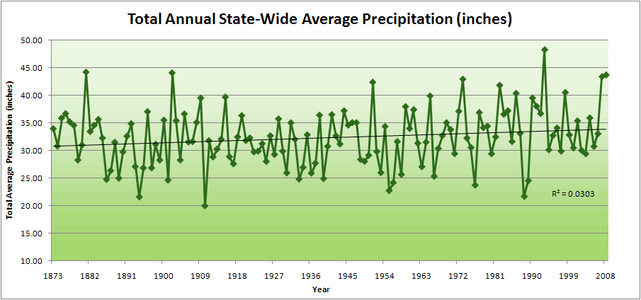
Iowa State-Wide Average Data

Slide 12
Iowa State-Wide Average Data
34.0”
10% increase
30.8”

Slide 13
Iowa State-Wide Average Data
Totals above 40”
8 years
2 years

Slide 14
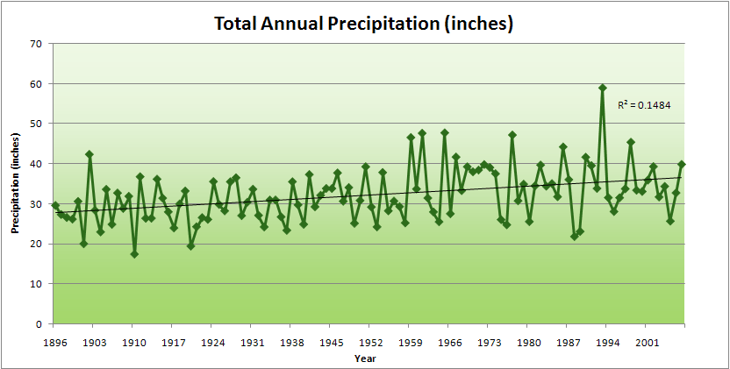
Cedar Rapids Data
Years with more than 40 inches
11
1
28.0”
32% increase
37.0”

Slide 15
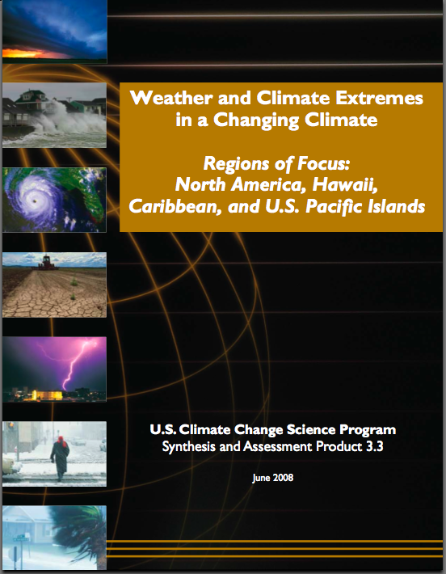
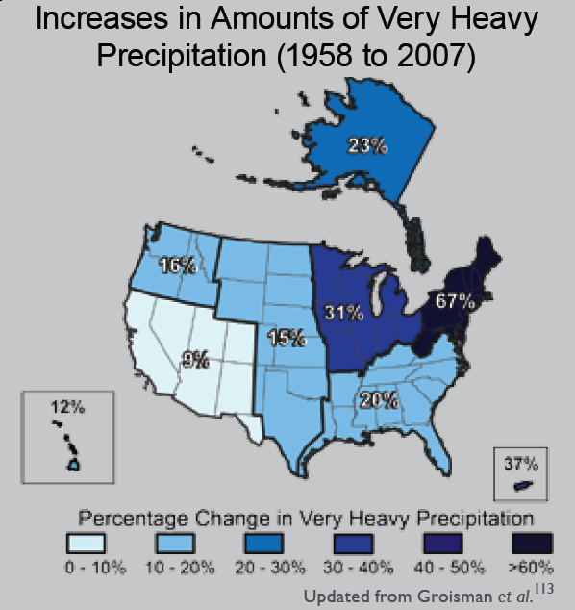
“One of the clearest trends in the United States observational record is an increasing frequency and intensity of heavy precipitation events… Over the last century there was a 50% increase in the frequency of days with precipitation over 101.6 mm (four inches) in the upper midwestern U.S.; this trend is statistically significant “
Karl, T. R., J. M. Melillo, and T. C. Peterson, (eds.), 2009: Global Climate Change Impacts in the United States. Cambridge University Press, 2009, 196pp.

Slide 16
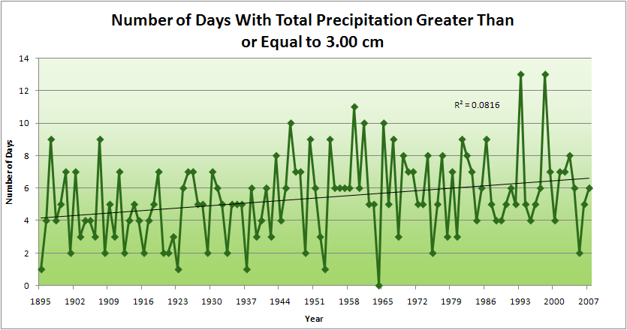
Cedar Rapids Data
1.25 inches
4.2 days
57% increase
6.6 days

Slide 17
Cedar Rapids Data
1.25 inches
Years having more than 8 days
13
2
4.2 days
57% increase
6.6 days

Slide 18
Years with more than 40 inches: 43% Increase
2010 so far

Slide 19
Years having more than 8 days
7
350% Increase
2
3.7
41% Increase
5.2

Slide 20
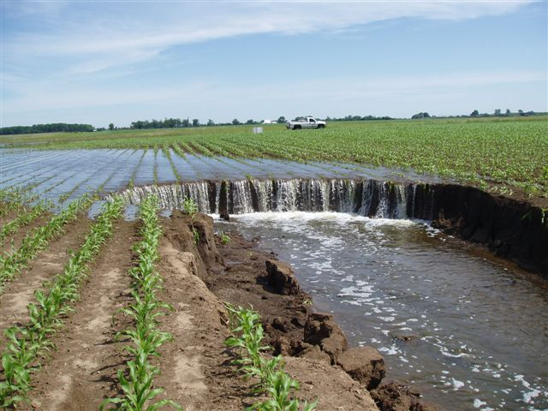
Photo courtesy of RM Cruse

Slide 21
Gilmore City, IA
M. Helmers

Slide 22
Low Precipitation
Low Nitrate Loss
Gilmore City, IA
M. Helmers

Slide 23
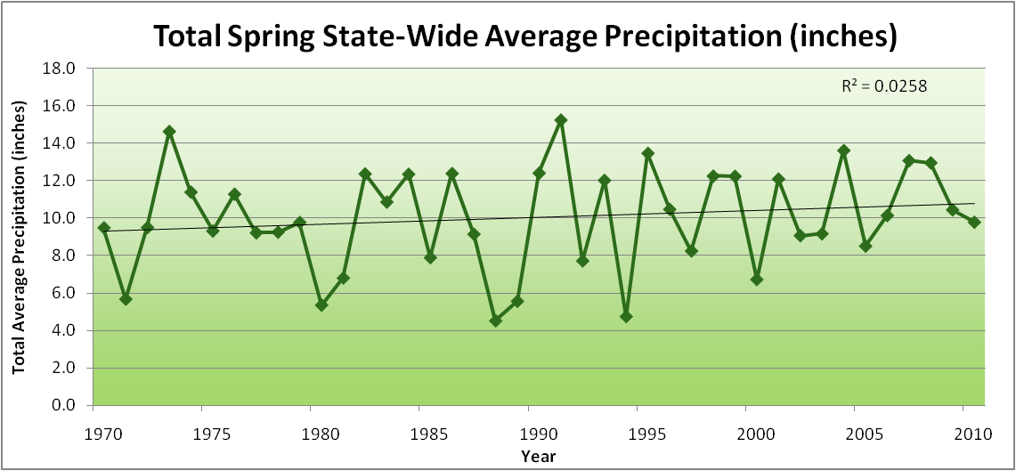
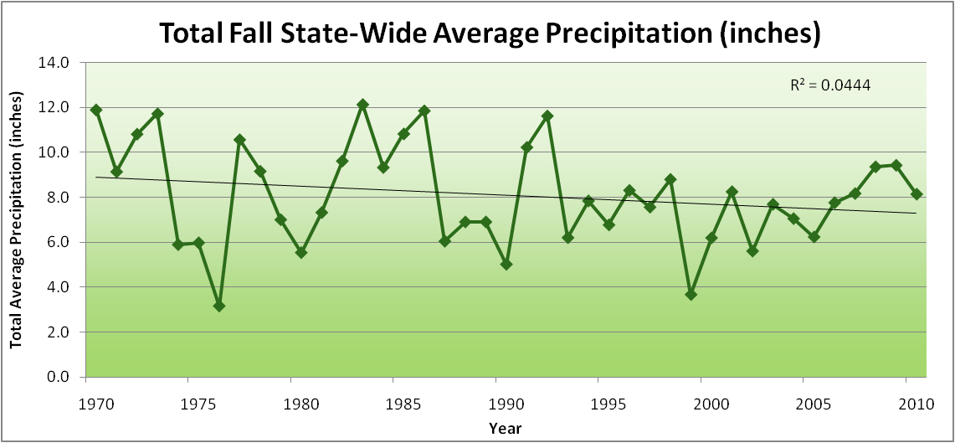
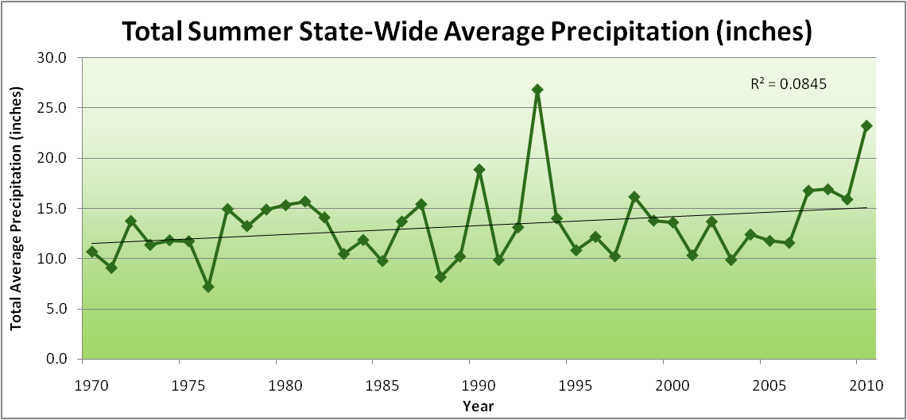
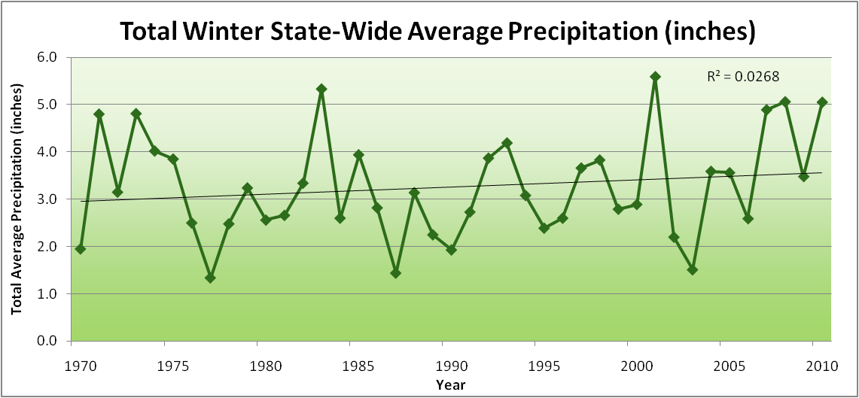
Amplification of the Seasonality of Precipitation
Spring
Fall
Summer
Winter

Slide 24
Amplification of the Seasonality of Precipitation
Spring
Fall
Summer
Winter

Slide 25
Amplification of the Seasonality of Precipitation
Spring
Fall
Summer
Winter

Slide 26
Amplification of the Seasonality of Precipitation
Spring
Fall
Summer
Winter

Slide 27
Amplification of the Seasonality of Precipitation
Spring
Fall
Summer
Winter

Slide 28
Amplification of the Seasonality of Precipitation
Spring
Fall
Summer
Winter

Slide 29
Amplification of the Seasonality of Precipitation
Spring
Fall
Summer
Winter

Slide 30
Amplification of the Seasonality of Precipitation
Spring
Fall
21.2 => 25.3 inches (22% increase)
12.1 => 10.5 inches (13% decrease)
Summer
Winter

Slide 31
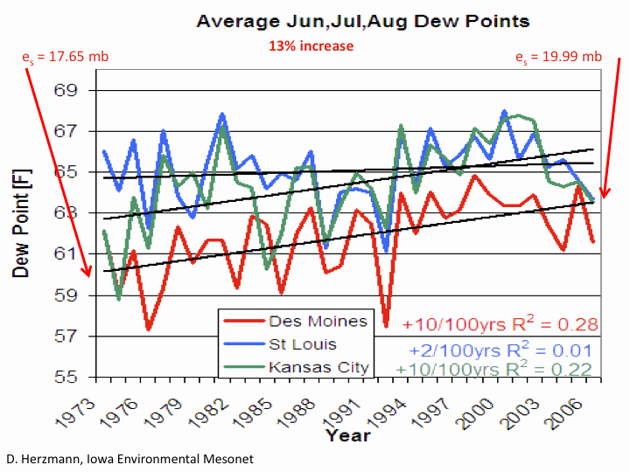

Slide 34
Iowa Agricultural Producers are Adapting to Climate Change:
Longer growing season: plant earlier, plant longer season hybrids, harvest later
Wetter springs: larger machinery enables planting in smaller weather windows
More summer precipitation: higher planting densities for higher yields
Wetter springs and summers: more subsurface drainage tile is being installed, closer spacing, sloped surfaces
Fewer extreme heat events: higher planting densities, fewer pollination failures
Higher humidity: more spraying for pathogens favored by moist conditions. more problems with fall crop dry-down, wider bean heads for faster harvest due to shorter harvest period during the daytime.
Drier autumns: delay harvest to take advantage of natural dry-down conditions, thereby reducing fuel costs
HIGHER YIELDS!!
Is it genetics or climate? Likely some of each.

Slide 35
Visioning Future Climate Change for Agriculture

Slide 36
Visioning Future Climate Change for Agriculture
You are here

Slide 37
Visioning Future Climate Change for Agriculture
You are here
Today

Slide 38
Visioning Future Climate Change for Agriculture
You are here
Today
Past

Slide 39
Visioning Future Climate Change for Agriculture
You are here
Today
Past
Future

Slide 40
Visioning Future Climate Change for Agriculture
You are here
?
Today
Past
Future

Slide 41
You be the scientist: For which hypothesis of the future can you find the most evidence?
?
Some Climate Variable (temp, precip, humid)
Today
Past
Future

Slide 42
You be the scientist: For which hypothesis of the future can you find the most evidence?
Some Climate Variable (temp, precip, humid)
Measured past
Today
Past
Future

Slide 43
You be the scientist: For which hypothesis of the future can you find the most evidence?
Some Climate Variable (temp, precip, humid)
Future will return to something in the past
Measured past
Today
Past
Future

Slide 44
You be the scientist: For which hypothesis of the future can you find the most evidence?
Future will be like average of the past
Some Climate Variable (temp, precip, humid)
Future will return to something in the past
Measured past
Today
Past
Future

Slide 45
You be the scientist: For which hypothesis of the future can you find the most evidence?
Future will be like today
Future will be like average of the past
Some Climate Variable (temp, precip, humid)
Future will return to something in the past
Measured past
Today
Past
Future

Slide 46
You be the scientist: For which hypothesis of the future can you find the most evidence?
Current trend will continue
Future will be like today
Future will be like average of the past
Some Climate Variable (temp, precip, humid)
Future will return to something in the past
Measured past
Today
Past
Future

Slide 47
You be the scientist: For which hypothesis of the future can you find the most evidence?
Future will be more extreme than today
Current trend will continue
Future will be like today
Future will be like average of the past
Some Climate Variable (temp, precip, humid)
Future will return to something in the past
Measured past
Today
Past
Future

Slide 48
You be the scientist: For which hypothesis of the future can you find the most evidence?
Future will be more extreme than today
Current trend will continue
Future will be like today
Future will be like average of the past
Some Climate Variable (temp, precip, humid)
Future will return to something in the past
Measured past
Today
Past
Future

Slide 49
You be the scientist: For which hypothesis of the future can you find the most evidence?
Some Climate Variable (temp, precip, humid)
Measured past
Today
Past
Future

Slide 50
You be the scientist: For which hypothesis of the future can you find the most evidence?
A Prudent View of the Future
Some Climate Variable (temp, precip, humid)
Measured past
Today
Past
Future

Slide 51
Future Challenges to Adaptation in the US Midwest (near term):
Wetter spring and early summer:
    Delayed planting
    Shallow rooting
More frequent and higher-intensity extreme rain events:
    Water-logged soils
    Lack of oxygen to roots
    More ponding (rural roads are becoming levees)
    Additional installation of subsurface tile drainage is inundating downstream urban areas
    Loss of nitrogen
Higher daily average temperatures (due to higher night-time temperatures):
    Differential acceleration of reproductive processes: pollination failure
    During grain-filling periods leads to higher nighttime respiration and reduced grain weight
    Loss of soil carbon
Increased humidity:
    More pressure from pests and pathogens
    Multiple stressors

Slide 52
Future Challenges to Adaptation in the US Midwest (long-term, occasional short-term):
Drought pattern from the west or south spills into Midwest:
    Underlying warming of the last 40 years caused by rise in CO₂ that has been buffered by high evaporative and transpiration cooling is unmasked
    High plant populations not sustainable on reduced moisture
    Prairie fires
    Wind erosion of soils
Overwintering of pests and pathogens formerly not able to survive extreme cold temperatures

Slide 53
Climate trends of the recent past have low statistical significance. Nevertheless, they have forced significant agricultural adaptation:

Slide 54
Climate trends of the recent past have low statistical significance. Nevertheless, they have forced significant agricultural adaptation:
Even climate trends of low statistical significance can have impacts of high agricultural significance

Slide 55
Sustaining agricultural production without depleting natural resources will become increasingly difficult with increasing levels of climate change

Slide 56
For More Information
Contact me directly:
gstakle@iastate.edu
Current research on regional climate and climate change is being conducted at Iowa State University under the Regional Climate Modeling Laboratory
http://rcmlab.agron.iastate.edu/
North American Regional Climate Change Assessment Program
http://www.narccap.ucar.edu/
Climate Science Program website:
http://climate.engineering.iastate.edu/
Or just Google Eugene Takle

